Slide 1

SYRIA TEL CUSTOMER CHURN PREDICTION PROJECT.
GROUP 1 PROJECT.

Slide 2

BUSINESS UNDERSTANDING.
This project aims to develop a predictive model that will help Syria Tel identify customers who are at a risk of churning away from the company and therefore come up with appropriate measures to protect the company from losses.

Slide 3

Project Objectives
We intend to achieve the following objectives:
1. Check how total call cost affects the churn rate.
2. Check how frequency of customer service call affects churning rate.
3. Check how international call cost affects the customers.
4. Check if night and day cost affect the customers.

Slide 4
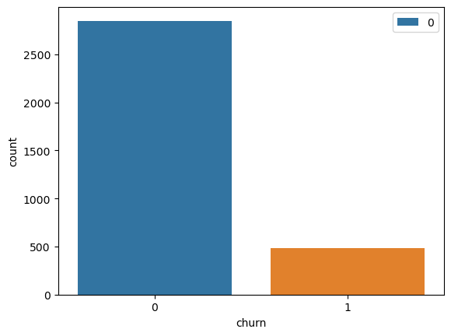
DATA UNDERSTANDING.
Using data from churn-in-telecoms. The data used in the project was obtained from Kaggle.com.
Data Reference: https://www.kaggle.com/datasets/becksddf/churn-in-telecoms-dataset.
The data consist of 330 records and 21 columns.
The following were observed :
Univariate analysis.
The total number of customers who churn and those who remained.

Slide 5
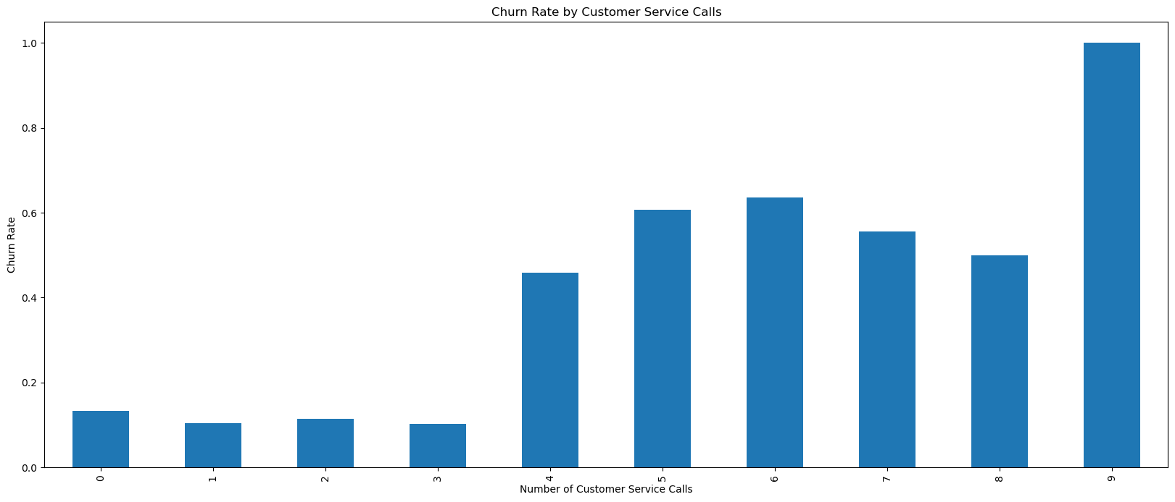
2. Bivariate Analysis.
To show relationship between the customers who churn and frequently called the customers serve.
It was observed that with high frequency call rate, the higher the rate of churn.

Slide 6
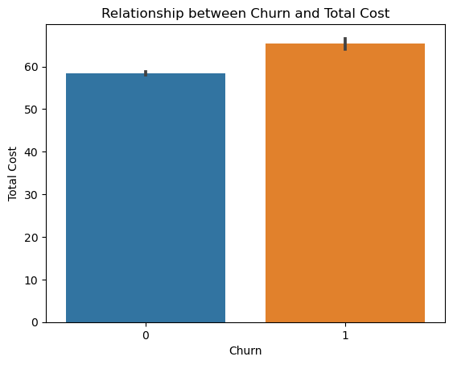
RELATIONSHIP BETWEEN THE CHURN AND TOTAL COST.
When the cost of call rate is high the rate of churn is also high.

Slide 7
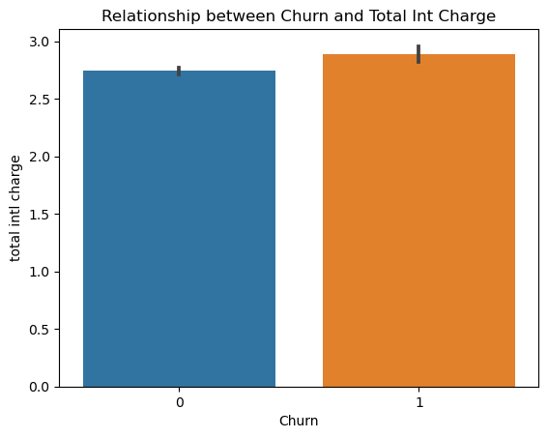
RELATIONSHIP BETWEEN CHURN AND TOTAL INTERNATIONAL CHARGE.
With an increase in the total international call cost the churn rate is also high.

Slide 8
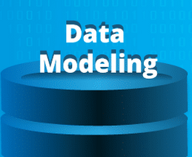
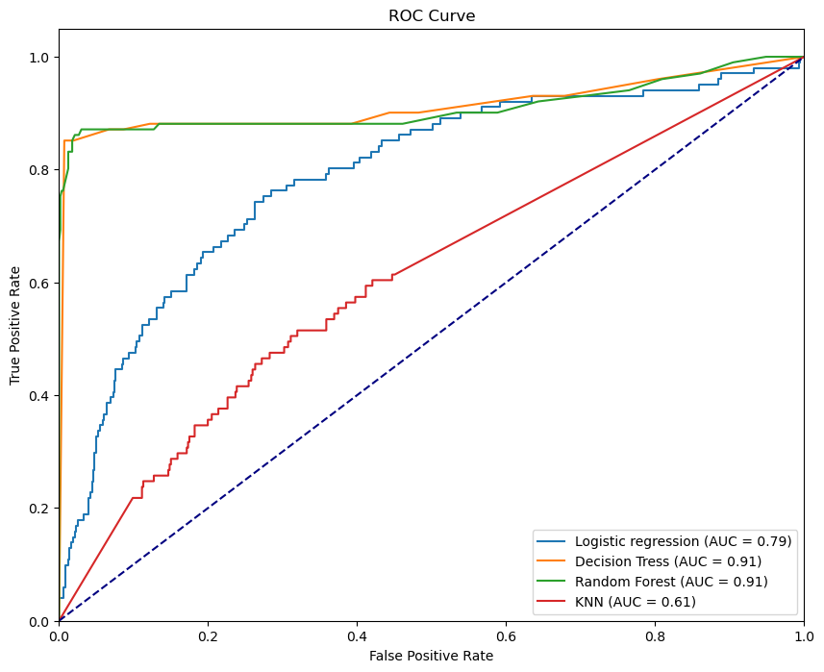
Various models were constructed to try and predict the churn rate. They were as follows;
1.Regression
2.Decision Tree
3.Random Forest
4.K-Nearest Neighbors.
The ROC Curve represents the results from the four models.

Slide 9
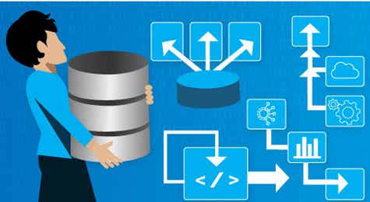
Random forest, gave the best performance metric where:
1. It has a high recall score of 0.83 which means it can capture a significant number of actual churn cases (83%) which is what we want
2. It has an accuracy score of 0.94 meaning that our model can correctly classify the churn cases
3. It also has a F1 score of 0.81 meaning that our model demonstrates a substantial ability to balance precision and recall resulting in accurate identification of True Positives
4. An AUC score of 0.897290 indicates that your model has good discrimination power in distinguishing between positive and negative instances.

Slide 10

The following features from our data influenced the rate of churning
Total cost – It was observed that higher total costs were associated with a higher churn rate.
No International call plan - Customers who did not have an international plan exhibited a higher churn rate.
Total day charge –A positive correlation between higher total day charges and a higher churn rate.
Customer service calls frequency - Customers who had a higher frequency of customer service calls demonstrated a higher churn rate.
Total international charge – It was observed that a higher total international charge was associated with a higher churn rate.

Slide 11

In order to reduce the churning rate of customers from Syria Tel, the following measures need to be put in place:
Total cost of calls through Syria tel should be lowered in order to reduce the rate of churn.
2. Customers who frequently call the customer service should have their issues addressed to lower chances of them churning.
3. More customers to be encouraged to join the international plan to reduce the churning rate.
4. Call cost for international calls should be lowered as a high rate leads to high rate of churning.

Slide 12
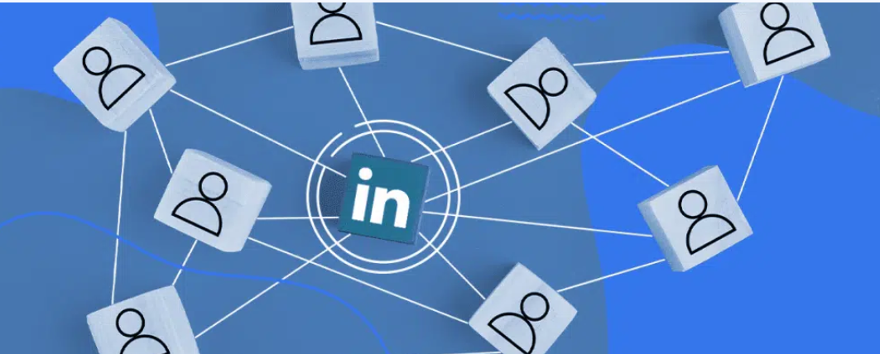
https://www.linkedin.com/in/purity-murugi
https://www.linkedin.com/in/leah-george
https://www.linkedin.com/in/vivian-watiri
https://www.linkedin.com/in/sammy-karapia

